Slide 1
Preparation du cours
Cours deja donnee en 2019 (ppt bleu en 2019) mais peut-etre amelioree. Me baser plutot sur Zemansky, plutot que sur ppt chinois.

Slide 2
Lesson 8: About the simple harmonic motion
Teacher: Dr. Paul Briard

Slide 3
Harmonic oscillations are a big topic in Physics
The sound is harmonic oscillations which propagates (oscillation of the local pressure).
The light is also the propagation of oscillations (of an electromagnetic field).
Any signal (such as electric signal: electric tension or intensity) is a sum of harmonic oscillations.
The description of the simple harmonic motion will be useful for us later.

Slide 4
Introduction: different kinds of periodic motion
The pendulum
Position of equilibrium

Slide 5
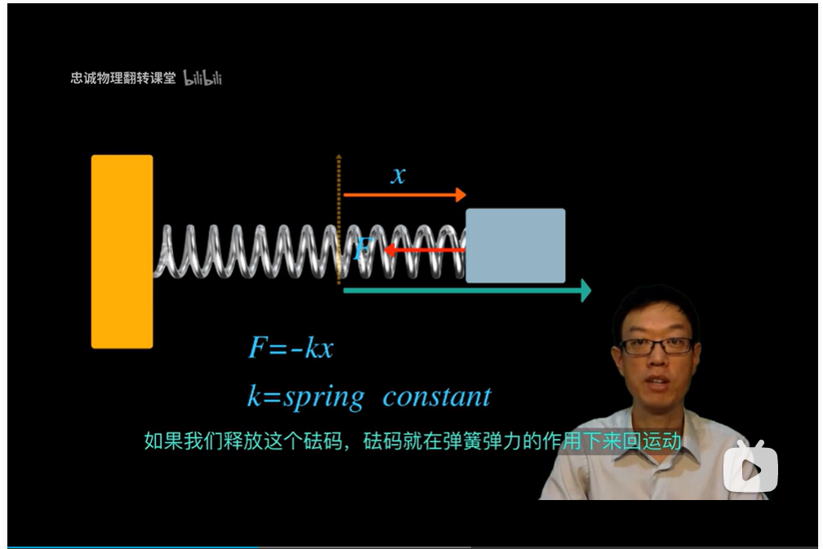
Introduction: different kinds of periodic motion
An horizontal (and then a vertical) spring-mass system
https://www.bilibili.com/video/BV1Fx411G7PU?from=search&seid=14076031412413100379&spm_id_from=333.337.0.0

Slide 6


Introduction: different kinds of periodic motion
A spring-mass system, at the vertical direction
Position of equilibrium

Slide 7
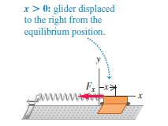
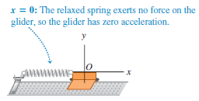
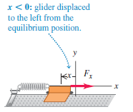
Introduction: different kinds of periodic motion
A spring-mass system, at the horizontal direction
We displace from equilibrium position the glider, then we release it with no-initial velocity. Friction is ignored. What is the motion of the glider ?

Slide 8
Summary: About a periodic motion
A body is displaced from an equilibrium position
A force (or sum of forces) is directed toward the equilibrium motion, which push or pull the body towards this equilibrium position.
But at the equilibrium position, the motion of body continues (because of the Newton’s first and second laws) until a position where its velocity is zero and go back toward the equilibrium position.
Periodic motion is involved with the forces acting on the body and the potential energy.

Slide 9
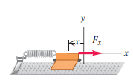
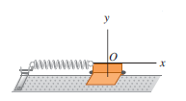





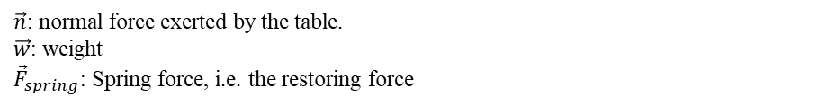







Description of a simple harmonic motion (SHM)
Middle of the glider is the x-coordinate of the glider. x=0 is the equilibrium position (i.e. , here the spring is not stretched or compressed)
$$x>0$$
$$x=0$$
$$x<0$$
Corresponding free body diagrams of the glider (friction ignored):
$$\vec{n}$$
$$\vec{n}$$
$$\vec{n}$$
$${\vec{F}}_{spring}$$
$${\vec{F}}_{spring}$$
$$\vec{w}$$
$$\vec{w}$$
$$\vec{w}$$
$\vec{n}$: normal force exerted by the table.
$\vec{w}$: weight
${\vec{F}}_{spring}$: Spring force, i.e. the restoring force

Slide 10





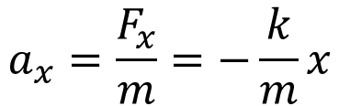
Description of a simple harmonic motion (SHM)
Using the Newton’s second law:
$$\vec{n}=−\vec{w}$$
$${\vec{F}}_{spring}=\vec{F}$$
where $\vec{F}=\vec{n}+\vec{w}+{\vec{F}}_{spring}$ is the net force on the glider.
The x-component of the force exerted by the spring (ideal, massless) on the glider is:
$$F_{spring,x}=F_{x}=−kx$$
(k is the spring coefficient)
The acceleration $\vec{a}$of the glider is described by (m is its mass):
$$m\vec{a}=\vec{F}$$
$$ma_{x}=F_{x}$$
We obtain a relation between the acceleration and the displacement from equilibrium:
$$a_{x}=\frac{F_{x}}{m}=−\frac{k}{m}x$$

Slide 11
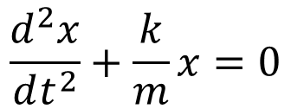
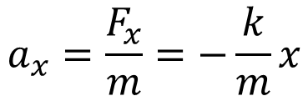
Description of a simple harmonic motion (SHM)
$$a_{x}=\frac{F_{x}}{m}=−\frac{k}{m}x$$
$$\frac{d^{2}x}{dt^{2}}+\frac{k}{m}x=0$$
This equation, where the acceleration is proportional to the displacement describe a “simple harmonic motion” or SHM
It is due to a restoring force proportional to the displacement from equilibrium.
It describes an oscillation around the equilibrium position.

Slide 12
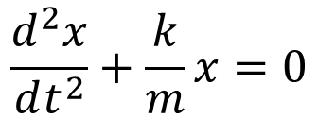
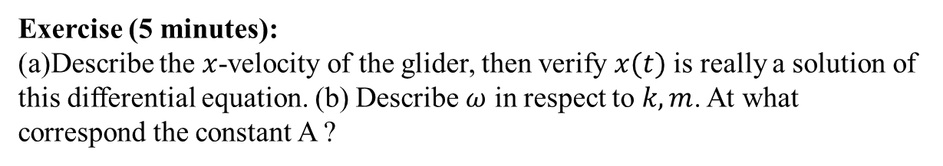

Description of a simple harmonic motion (SHM)
$$\frac{d^{2}x}{dt^{2}}+\frac{k}{m}x=0$$
Solutions of this equation are in the form (A, $ω, φ$ are constants, $A>0$, and by convention $ω>0$ ):
$$x\left(t\right)=A\cos\left(ωt+φ\right)$$
(I don’t describe now how we obtain the solutions, because it could be a bit complicated, I will say it later, when you will be more familiar with SHM )
Exercise (5 minutes):
(a)Describe the $x$-velocity of the glider, then verify $x(t)$ is really a solution of this differential equation. (b) Describe $ω$ in respect to $k,m$. At what correspond the constant A ?

Slide 13
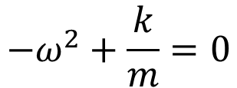

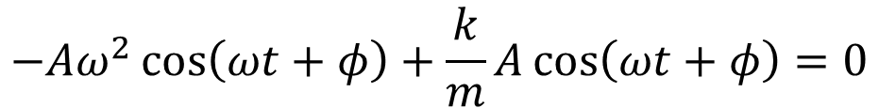
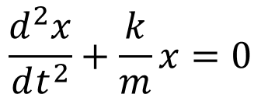
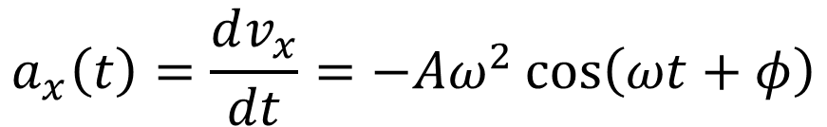
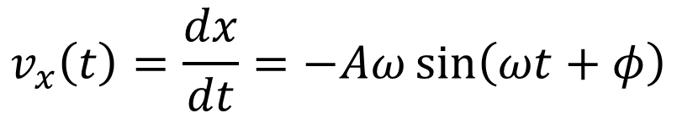

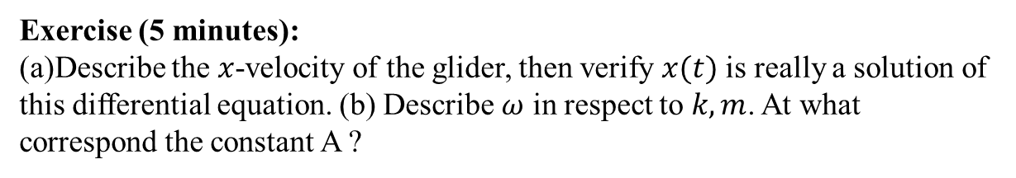
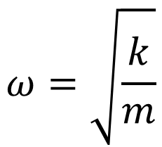
$$\frac{d^{2}x}{dt^{2}}+\frac{k}{m}x=0$$
$$x\left(t\right)=A\cos\left(ωt+φ\right)$$
Exercise (5 minutes):
(a)Describe the $x$-velocity of the glider, then verify $x(t)$ is really a solution of this differential equation. (b) Describe $ω$ in respect to $k,m$. At what correspond the constant A ?
$$v_{x}\left(t\right)=\frac{dx}{dt}=−Aω\sin\left(ωt+φ\right)$$
$$a_{x}\left(t\right)=\frac{dv_{x}}{dt}=−Aω^{2}\cos\left(ωt+φ\right)$$
$$−Aω^{2}\cos\left(ωt+φ\right)+\frac{k}{m}A\cos\left(ωt+φ\right)=0$$
$x\left(t\right)=A\cos\left(ωt+φ\right)$ is solution and,
$$ω=\sqrt{\frac{k}{m}}$$
$$−ω^{2}+\frac{k}{m}=0$$

Slide 14





$$\frac{d^{2}x}{dt^{2}}+\frac{k}{m}x=0$$
$$x\left(t\right)=A\cos\left(ωt+φ\right)$$
Exercise (5 minutes):
(a)Describe the $x$-velocity of the glider, then verify $x(t)$ is really a solution of this differential equation. (b) Describe $ω$ in respect to $k,m$. At what correspond the constant A ?
$$x\left(t\right)=A\cos\left(ωt+φ\right)$$
The maximum value of $\cos\left(ωt+φ\right)$ is$1$
$$x=A$$
The minimum value of $\cos\left(ωt+φ\right)$ is$−1$
$$x=−A$$
The glider oscillates between the positions $x=A$ and $x=−A$

Slide 15
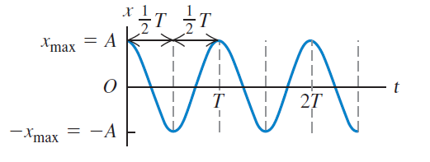
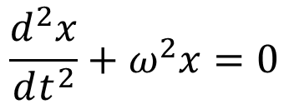

Description of a simple harmonic motion (SHM)
Single harmonic motion is the +x-direction is described by:
$$\frac{d^{2}x}{dt^{2}}+ω^{2}x=0$$
Solutions of this equation are in the form (A, $ω, φ$ are constants ), it is named also “sinusoidal motion”:
$$x\left(t\right)=A\cos\left(ωt+φ\right)$$

Slide 16


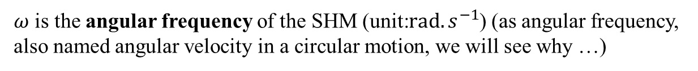
Description of a simple harmonic motion (SHM)
Solutions of this equation are in the form (A, $ω, φ$ are constants ), it is named also “sinusoidal motion”:
$$x\left(t\right)=A\cos\left(ωt+φ\right)$$
A is the amplitude of the SHM (SI unit: m), corresponding to extremum of displacement.
$ω$ is the angular frequency of the SHM (unit:$rad.s^{−1}$) (as angular frequency, also named angular velocity in a circular motion, we will see why …)
$T=\frac{2π}{ω}$ is the period of the SHM (unit: s)

Slide 17


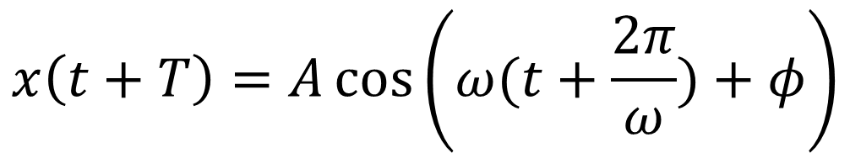
About the period of a SHM
$$x\left(t\right)=A\cos\left(ωt+φ\right)$$
$$x\left(t+T\right)=A\cos\left(ω(t+T)+φ\right)$$
$$x\left(t+T\right)=A\cos\left(ω(t+\frac{2π}{ω})+φ\right)$$
$$x\left(t+T\right)=A\cos\left(ωt+2π+φ\right)$$
$$x\left(t+T\right)=A\cos\left(ωt+φ\right)=x(t)$$
After a period T (we say also “after a cycle”), the body in SHM has returns to the same displacement, velocity, and acceleration (it is possible because friction has been ignored)
Number of cycles per second is the frequency (unit: Hz )
$$f=1/T$$

Slide 18




Phase of a SHM
$$x\left(t\right)=A\cos\left(ωt+φ\right)$$
Phase at origin of the SHM (unit: rad), also named “phase offset”
The phase of the SHM depends to the choice of the origin of time:
$$x\left(t=0\right)=A\cos{φ}$$
$$x\left(t=0\right)=A\cos{φ}$$
$$t=0$$
If we choose the origin of time here

Slide 19


Phase (or phase angle) of a SHM
$$x\left(t\right)=A\cos\left(ωt+φ\right)$$
Phase at origin of the SHM (unit: rad), also named “phase offset”
The phase of the SHM depends to the choice of the origin of time:
$$x\left(t=0\right)=A\cos{φ}$$
However, we have seen that the choice of the origin of time is arbitrary, so we can say “the origin of time is such as at $t=0, x\left(t=0\right)=A$”
$$x\left(t=0\right)=A\cos{φ}=A$$
$$\cos{φ}=1$$
The SHM is then described by:
$$x\left(t\right)=A\cos\left(ωt\right)$$
Warning: For only one SHM, we don’t mind of the phase. But take care if more that one SHM are studied !

Slide 20
Lecture 11, still lesson 8: Simple harmonic motion
Teacher: Paul Briard

Slide 21
About quick test of Wednesday
Everything we have seen together until now,
Included the rotation of rigid bodies (and included the angular momentum we have described last week)
excluded the simple harmonic motion.

Slide 22
About quick test of Wednesday
Duration of the quick test: 45 minutes
Rules: same than for examination:
Chinese-English dictionary allowed
Calculator without memory allowed (you could have forgotten to buy one, or you could forgot to take it at the test, in that case, you try to calculate the result by yourself)
Phones and calculators with memory not allowed
You have to remember the equations needed to solve the exercises (I say you in classroom what are the important equations to remember).

Slide 23
About quick tests
The purpose of quick tests is to help you to prepare examination.
But don’t wait a quick test to begin to prepare an exam, you should do it during the whole semester.
In classroom and with your homework, you do half of the work
The second half is to practice by yourself (depending to the time available you have).

Slide 24
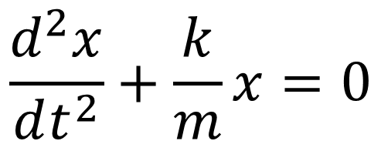

Reminder of previous lecture
Example of horizontal simple harmonic motion (SHM):
Spring constant (or spring coefficient)
$$\frac{d^{2}x}{dt^{2}}+\frac{k}{m}x=0$$
Using the Newton’s second law and ignoring all frictions:
Mass of the glider
Which the solution is:
$$x\left(t\right)=A\cos\left(ωt+φ\right)$$

Slide 25

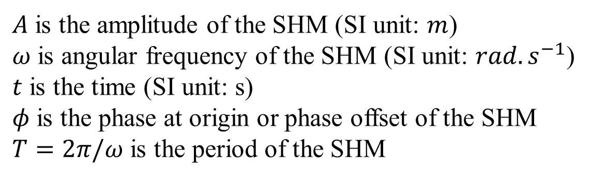
Reminder of previous lecture
$$x\left(t\right)=A\cos\left(ωt+φ\right)$$
$A$ is the amplitude of the SHM (SI unit: $m$)
$ω$ is angular frequency of the SHM (SI unit: $rad.s^{−1}$)
$t$ is the time (SI unit: s)
$φ$ is the phase at origin or phase offset of the SHM
$T=2π/ω$ is the period of the SHM

Slide 26


Phase (or phase angle) of a SHM
$$x\left(t\right)=A\cos\left(ωt+φ\right)$$
The term inside the cosines is an angle, named the “phase” or “phase angle” of the SHM
Reference circle of the SHM
$$ωt+φ$$
SHM is related with a uniform circular motion

Slide 27

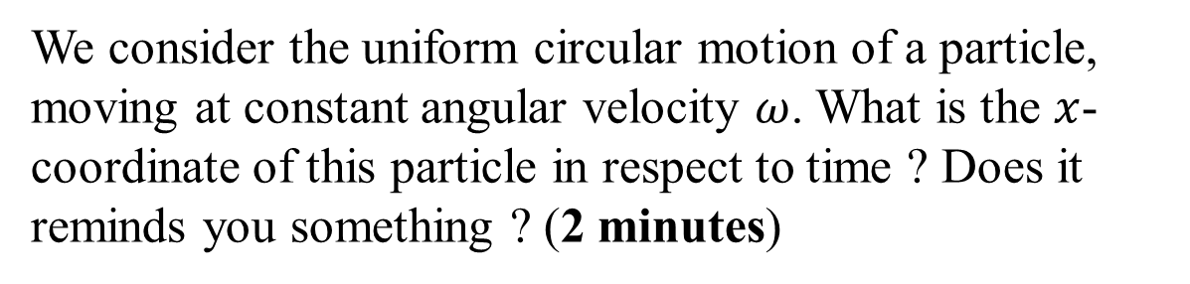



Circular motion and SHM: introduction
$$y$$
$$x_{max}$$
$$x$$
$$x\left(t\right)=?$$
We consider the uniform circular motion of a particle, moving at constant angular velocity $ω$. What is the $x$-coordinate of this particle in respect to time ? Does it reminds you something ? (2 minutes)

Slide 28




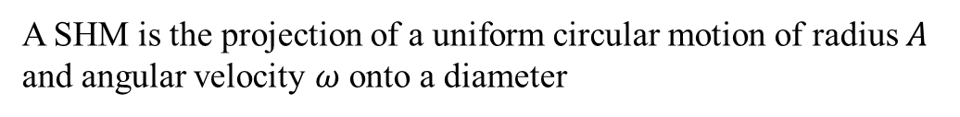


Circular motion and SHM
$$y$$
$$θ\left(t\right)=ωt+φ$$
$$x$$
$$x\left(t\right)$$
$$x_{max}=A$$
$$−x_{max}=−A$$
A SHM is the projection of a uniform circular motion of radius $A$ and angular velocity $ω$ onto a diameter
$$x\left(t\right)=A\cos{θ(t)}=A\cos\left(ωt+φ\right)$$
This circle is named “reference circle of the SHM ”

Slide 29




Circular motion and SHM
$$y$$
Q
$${\vec{a}}_{Q}$$
$$θ\left(t\right)=ωt+φ$$
P
$$x$$
$$x\left(t\right)$$
$$x_{max}=A$$
$$−x_{max}=−A$$
Q has a uniform circular motion, i.e. its acceleration is directed toward the center of the circle and has magnitude
$$a_{q}=ω^{2}A$$
P and Q have the same acceleration along the x-direction: $a_{x}$
$$a_{x}+ω^{2}x=0$$
$$a_{x}=−ω^{2}x=−ω^{2}Acos θ(t)$$

Slide 30





Phase angle in the reference circle
$$y$$
At $t=0$, for instance
$$θ\left(t\right)$$
$$φ=θ(t=0)$$
$$x$$
$$x\left(t\right)$$
$$x\left(t=0\right)$$
$$x\left(t\right)=A\cos{θ(t)}=A\cos\left(ωt+φ\right)$$
$$θ\left(t=0\right)=φ$$
Phase at origin (or phase offset )

Slide 31


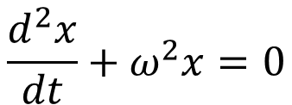
Summary
Simple harmonic motion (SHM), in the $x$-direction:
$$x\left(t\right)=A\cos\left(ωt+φ\right)$$
Important to remember
amplitude
Angular frequency
Phase at origin (or phase offset)
$$ω=\frac{2π}{T}=2πf$$
$T$ is the period of one cycle. $f$ is the frequency, i.e. the number of cycles per unit time,
Solution of the equation:
$$\frac{d^{2}x}{dt}+ω^{2}x=0$$
Important to remember

Slide 32
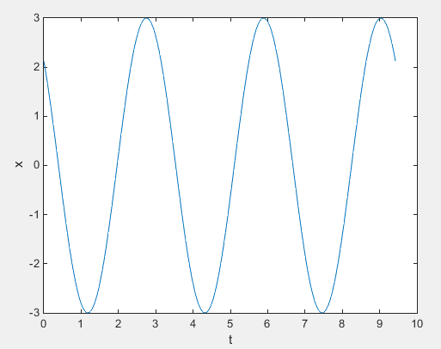
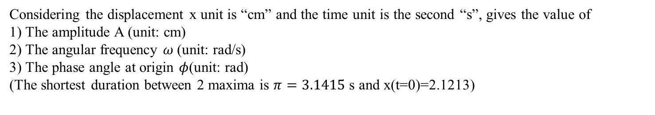
Graph of displacement x versus time t in a SHM (5 minutes)
Considering the displacement x unit is “cm” and the time unit is the second “s”, gives the value of
1) The amplitude A (unit: cm)
2) The angular frequency $ω$(unit: rad/s)
3) The phase angle at origin $φ$(unit: rad)
(The shortest duration between 2 maxima is $π=3.1415$ s and x(t=0)=2.1213)

Slide 33

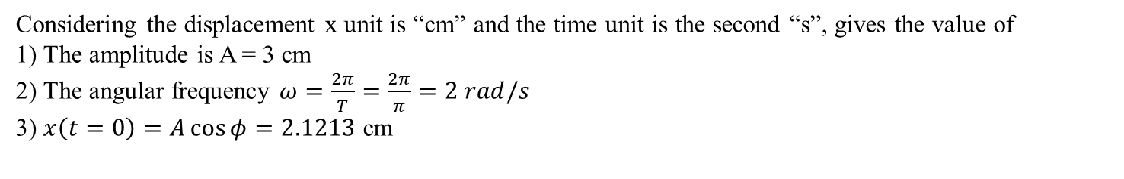
Graph of displacement x versus time t in a SHM: Solution
$$π=3.1415 s$$
Considering the displacement x unit is “cm” and the time unit is the second “s”, gives the value of
1) The amplitude is A = 3 cm
2) The angular frequency $ω=\frac{2π}{T}=\frac{2π}{π}=2 rad/s$
3) $x\left(t=0\right)=A\cos{φ=2.1213}$ cm
$$φ=arccos\left(\frac{x(t=0)}{A}\right)=arccos\left(\frac{2.1213}{3}\right)=0.7854 rad=\frac{π}{4} rad$$

Slide 34



Graph of displacement x versus time t in a SHM
$$x=A$$
$$x=A\cos{φ}$$
$$T=\frac{1}{f}=\frac{2π}{ω}$$
2A
Here, the function computed is $x=3\cos{(2t+π/4)}$

Slide 35





SHM with non-zero initial velocity
What if the glider has a initial velocity $v_{x}(t=0)≠0$ ?
$$at t=0, x\left(t\right)=x_{0},v_{x}\left(t=0\right)=v_{0,x}≠0$$
$$x\left(t\right)=A\cos\left(ωt+φ\right)$$
$$v_{x}\left(t\right)=−ωA\sin{(ωt+φ)}$$
$$x\left(t=0\right)=x_{0}=A\cos\left(φ\right)$$
$$x_{0}^{2}=A^{2}\cos^{2}φ$$
$$v_{x}\left(t=0\right)=v_{0,x}=−ωA\sin{(φ)}$$
$$v_{0,x}^{2}/ω^{2}=A^{2}\sin^{2}φ$$
$${x_{0}}^{2}+\frac{v_{0,x}^{2}}{ω^{2}}=A^{2}\left(\cos^{2}φ +\sin^{2}φ \right)=A^{2}$$

Slide 36
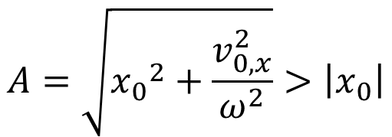
SHM with non-zero initial velocity
What if the glider has a initial velocity $v_{x}(t=0)≠0$ ?
$$at t=0, x\left(t\right)=x_{0},v_{x}\left(t=0\right)=v_{0,x}≠0$$
If at the initial time, we release the glider with a non-zero initial velocity $v_{0,x}$ at initial displacement from equilibrium $x_{0},$what happens for its motion ?
The net force and the spring force are described by the same way than previously, the Newton’s 2nd law is still applied by the same way than previously
The displacement of the glider is still described by:
$$x\left(t\right)=A\cos\left(ωt+φ\right)$$
But the amplitude of the SHM is:
$$A=\sqrt{{x_{0}}^{2}+\frac{v_{0,x}^{2}}{ω^{2}}}>\left|x_{0}\right|$$

Slide 37






Energy involved in SHM
We still consider the horizontal motion of a glider of mass $m$ associated with a spring, the friction is ignored.
The kinetic energy of the glider is:
$$E_{k}=\frac{1}{2}m{v_{x}}^{2}$$
The potential energy of the glider is:
$$E_{p}=\frac{1}{2}kx^{2}$$
where the equilibrium position $x=0$ is chosen to correspond to
$$E_{p}=0$$
Only the spring force does work on the glider (a conservative force), thus its mechanical energy $E_{m}$ is constant.
$$E_{m}=E_{p}+E_{k}=constant$$
When $x\left(t\right)=A, v_{x}\left(t\right)=0$
$$\frac{1}{2}m{v_{x}}^{2}+\frac{1}{2}kx^{2}=\frac{1}{2}kA^{2}$$

Slide 38
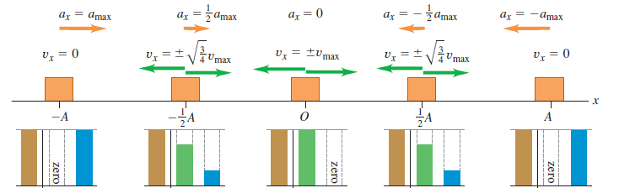


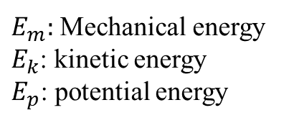















Energy involved in SHM
$$x=0$$
$$x$$
$$E_{m}$$
$$E_{k}$$
$$E_{p}$$
$$E_{m}$$
$$E_{k}$$
$$E_{p}$$
$$E_{m}$$
$$E_{k}$$
$$E_{p}$$
$$E_{m}$$
$$E_{k}$$
$$E_{p}$$
$$E_{m}$$
$$E_{k}$$
$$E_{p}$$
$E_{m}:$ Mechanical energy
$E_{k}$: kinetic energy
$E_{p}$: potential energy

Slide 39
Energy involved in SHM
$$x$$
$$E_{m}$$
$$E_{k}$$
$$E_{p}$$
$$E_{m}$$
$$E_{k}$$
$$E_{p}$$
$$E_{m}$$
$$E_{k}$$
$$E_{p}$$
$$E_{m}$$
$$E_{k}$$
$$E_{p}$$
$$E_{m}$$
$$E_{k}$$
$$E_{p}$$
$E_{m}:$ Mechanical energy
$E_{k}$: kinetic energy
$E_{p}$: potential energy

Slide 40

Energy involved in SHM
$$x$$
$$E_{m}$$
$$E_{k}$$
$$E_{p}$$
$$E_{m}$$
$$E_{k}$$
$$E_{p}$$
$$E_{m}$$
$$E_{k}$$
$$E_{p}$$
$$E_{m}$$
$$E_{k}$$
$$E_{p}$$
$$E_{m}$$
$$E_{k}$$
$$E_{p}$$
$E_{m}:$ Mechanical energy
$E_{k}$: kinetic energy
$E_{p}$: potential energy

Slide 41
Energy involved in SHM
$$x$$
$$E_{m}$$
$$E_{k}$$
$$E_{p}$$
$$E_{m}$$
$$E_{k}$$
$$E_{p}$$
$$E_{m}$$
$$E_{k}$$
$$E_{p}$$
$$E_{m}$$
$$E_{k}$$
$$E_{p}$$
$$E_{m}$$
$$E_{k}$$
$$E_{p}$$
$E_{m}:$ Mechanical energy
$E_{k}$: kinetic energy
$E_{p}$: potential energy

Slide 42
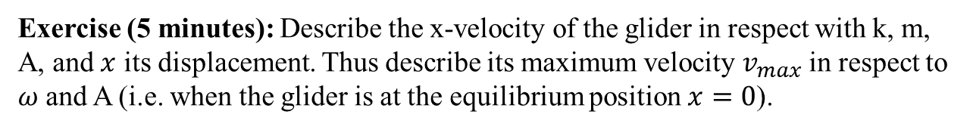
Energy involved in SHM
$$E_{m}$$
$$E_{k}$$
$$E_{p}$$
$$E_{m}$$
$$E_{k}$$
$$E_{p}$$
$$E_{m}$$
$$E_{k}$$
$$E_{p}$$
$$E_{m}$$
$$E_{k}$$
$$E_{p}$$
$$E_{m}$$
$$E_{k}$$
$$E_{p}$$
$E_{m}:$ Mechanical energy
$E_{k}$: kinetic energy
$E_{p}$: potential energy
Exercise (5 minutes): Describe the x-velocity of the glider in respect with k, m, A, and $x$ its displacement. Thus describe its maximum velocity $v_{max}$ in respect to $ω$ and A (i.e. when the glider is at the equilibrium position $x=0$).

Slide 43
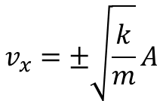



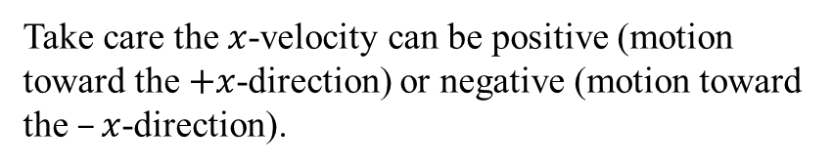
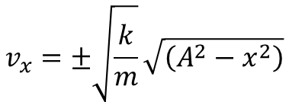


Energy involved in SHM
$$\frac{1}{2}m{v_{x}}^{2}+\frac{1}{2}kx^{2}=\frac{1}{2}kA^{2}$$
$$m{v_{x}}^{2}=kA^{2}−kx^{2}$$
$$v_{x}^{2}=\frac{k}{m}\left(A^{2}−x^{2}\right)$$
$$v_{x}=±\sqrt{\frac{k}{m}}\sqrt{\left(A^{2}−x^{2}\right)}$$
Take care the $x$-velocity can be positive (motion toward the $+x$-direction) or negative (motion toward the $–x$-direction).
$$v_{x}=±\sqrt{\frac{k}{m}}A$$
At $x=0$,
$$v_{max}=ωA$$

Slide 44



Phase difference between two SHMs
We wish to study the motion of two gliders in horizontal motion associated with spring. The origin of time must be the same for both motions !
$$1$$
$$glider 1$$
2
$$glider 2$$

Slide 45






Phase difference between two SHMs
We wish to study the motion of two gliders in horizontal motion associated with spring. The origin of time must be the same for both motions !
$$x(t)$$
Reference circle:
$$t$$
$$x_{1}=A_{1}\cos\left(ωt+φ_{1}\right)$$
Phase difference:
$$Δφ=φ_{2}−φ_{1}$$
$$x_{2}=A_{2}\cos\left(ωt+φ_{2}\right)$$
Here, $Δφ=φ_{2}−φ_{1}=π/2$

Slide 46
Other examples of SHM
Different kinds of spring-mass systems, here the weight and/or the normal force could be involved …

Slide 47
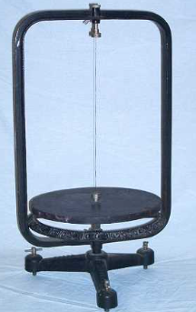
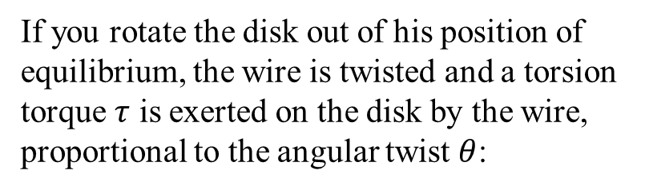
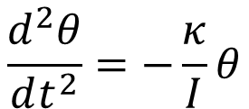


Angular SHM with a torsion pendulum (friction ignored)
If you rotate the disk out of his position of equilibrium, the wire is twisted and a torsion torque $τ$ is exerted on the disk by the wire, proportional to the angular twist $θ$:
wire
$$τ=−κθ$$
Using the rotational equivalent to the Newton’s 2nd law, we obtain the angular acceleration described by:
disk
$$\frac{d^{2}θ}{dt^{2}}=−\frac{κ}{I}θ$$
$$θ$$
Where I is the moment of inertia of the disk about the axis of rotation
http://physics.kenyon.edu/EarlyApparatus/Mechanics/Torsion_Pendulum/Torsion_Pendulum.html

Slide 48


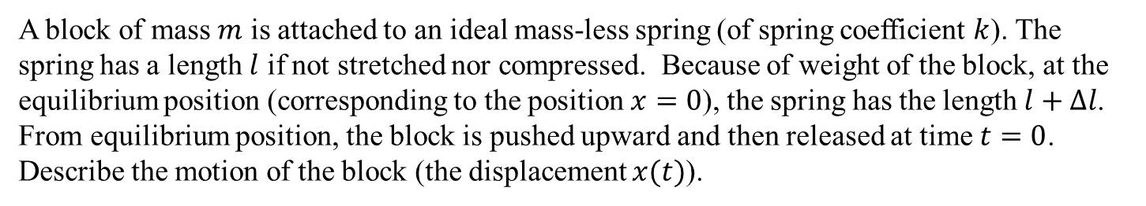



Ex: A vertical spring-mass system (friction ignored)
$$l$$
Take care that at equilibrium position, there is a spring force exerted on the block because the spring has been stretched.
$$∆l$$
$$x$$
$$x=0$$
A block of mass $m$ is attached to an ideal mass-less spring (of spring coefficient $k$). The spring has a length $l$ if not stretched nor compressed. Because of weight of the block, at the equilibrium position (corresponding to the position $x=0$), the spring has the length $l+Δl$. From equilibrium position, the block is pushed upward and then released at time $t=0$.
Describe the motion of the block (the displacement $x(t)$).

Slide 49
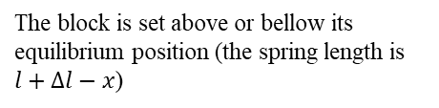

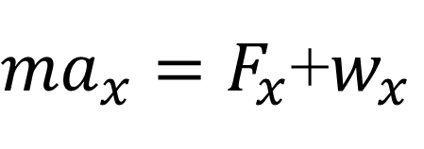


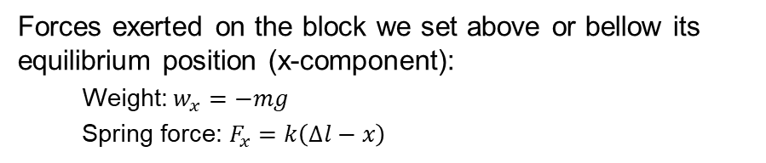

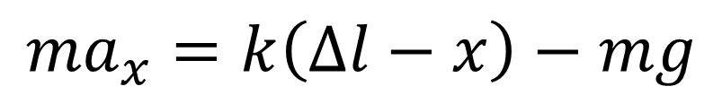
Ex: A vertical spring-mass system (friction ignored)
Forces exerted on the block we set above or bellow its equilibrium position (x-component):
Weight: $w_{x}=−mg$
Spring force: $F_{x}=k\left(∆l−x\right)$
$$l$$
Using the Newton’s second law:
$$∆l$$
${ma}_{x}=F_{x}$+$w_{x}$
$$x$$
$$x=0$$
$${ma}_{x}=k\left(∆l−x\right)−mg$$
The block is set above or bellow its equilibrium position (the spring length is $l+∆l−x$)
x-component of the acceleration

Slide 50
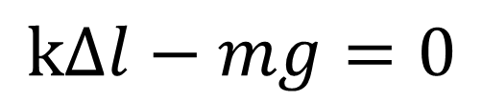





Ex: A vertical spring-mass system (friction ignored)
And by applying Newton’s 2nd law when the block is at equilibrium position:
$$l$$
$$k∆l−mg=0$$
$${ma}_{x}=k\left(∆l−x\right)−mg$$
$$∆l$$
$$x$$
$$x=0$$
$$a_{x}=−\frac{k}{m}x=\frac{d^{2}x}{dt^{2}}$$
$$\frac{d^{2}x}{dt^{2}}+\frac{k}{m}x=0$$
$$x\left(t\right)=A\cos\left(ωt+φ\right)$$
$$ω=\sqrt{k/m}$$

Slide 51
Lecture 12, still lesson 8: The simple harmonic motion
Teacher: Paul Briard

Slide 52
Before to continue: The quick test
I give you papers for draft. Use it to write something as “clean” as possible when you write on the examination paper !
Don’t cheat ! (it is meaningless, you are not middle school kids and I hate cheating, I give score = 0 when that happens).
Rules:
Duration: 45 minutes,
phone and calculator with memory are not allowed (let them in your bag, close your bag)
Chinese-English dictionary and calculator without memory are allowed (if you forgot one of them, you try to do the quick test without it)
If you have a question, you don’t ask to your classmate. You ask me.

Slide 53
Rest time

Slide 54






The simple pendulum (friction ignored)
Simple pendulum: all the mass of the body oscillating is concentrated on a single point-mass of mass m attached to a massless (and unstretchable) string.
Tension force exerted by the string on the particle
$$\vec{T}$$
$$L$$
$$θ$$
mass m
$$s=Lθ$$
Equilibrium
position
$$\vec{w}=m\vec{g}$$
weight
Question (5 minutes): Describe the tangential net force exerted om the particle. What is the restoring force, here ? Is the motion described by $s\left(t\right)=Lθ(t)$ of a simple pendulum a SHM or not ?

Slide 55













The simple pendulum (friction ignored)
The tangential net force on the particle is:
$$\vec{F_{t}}=F_{t}\hat{t}$$
where $F_{t}$ is the tangential component of the net force and $\hat{t}$ is the tangent unit vector.
$$L$$
$$θ$$
$$\vec{T}$$
$$\hat{t}$$
$$s$$
The restoring force corresponds to the tangential component of the net force on the particle, which is:
mass m
$$\vec{F_{t}}$$
$$\vec{w}$$
$$θ$$
$$F_{t}(θ)=−mg\sin{θ}$$
$$mg\sin{θ}$$
$θ=0$ corresponds to the position of equilibrium, $F_{t}\left(θ\right)=0$
$0<θ≤π/2$corresponds to pendulum at the right of the position of equilibrium, $F_{t}\left(θ\right)<0$
$-π/2≤θ<0$ corresponds to pendulum at the left of the position of equilibrium, $F_{t}\left(θ\right)>0$
Although the motion is alternatively clockwise or anticlockwise, we choose $\hat{t}$ to be always anticlockwise which simplify the description of the motion of the pendulum.

Slide 56











The simple pendulum (friction ignored)
The restoring force corresponds to the tangential component of the net force on the particle, which is:
$$F_{t}=−mg\sin{θ}=−mg\sin\left(\frac{s}{L}\right)$$
The restoring force is not proportional with the curvilinear displacement s$(t)$ !
$$L$$
$$θ$$
$$\vec{T}$$
mass m
The simple pendulum motion is not a SHM !
$$s$$
$$\vec{F_{t}}$$
However, if the angular displacement is quite small, for instance :$\left|θ\right|<0.1 rad$
$$\vec{w}$$
$$θ$$
$$mg\sin{θ}$$
$$\frac{\sin{θ}}{θ}≈1$$
If the angular displacement is quite small, the simple pendulum motion is approximately an SHM
$$F_{t}(θ)≈−mgθ$$
$$F_{t}(s)≈−mg\frac{s}{L}$$

Slide 57











The simple pendulum (friction ignored)
$$\frac{\sin{θ}}{θ}≈1$$
$$F_{t}\left(s\right)≈−\frac{mgs}{L}$$
$$F_{t}(θ)≈−mgθ$$
The motion is approximatively a SHM if $\sin{θ}≈θ$
The curvilinear displacement $s\left(t\right)=Lθ(t)$ describes a SHM.
Using the Newton 2nd’s law:
$$mL\frac{d^{2}θ}{{dt}^{2}}≈−mgθ$$
$$\frac{d^{2}s}{{dt}^{2}} =L\frac{d^{2}θ}{{dt}^{2}}$$
and
$$m\frac{d^{2}s}{{dt}^{2}}≈−\frac{mg}{L}s$$
$$\frac{d^{2}s}{{dt}^{2}}+\frac{g}{L}s≈0$$
Which the solutions are:
$$s(t)≈s_{m}\cos\left(ωt+φ\right)$$
With $ω=\sqrt{\frac{g}{L}}$
$$T=\frac{2π}{ω}=2π\sqrt{\frac{L}{g}}$$
Amplitude of the SHM
$$s_{m}$$
You don’t need to remember this result but you must be able to find it by yourself.

Slide 58











The simple pendulum (friction ignored)
$$\frac{\sin{θ}}{θ}≈1$$
$$\frac{d^{2}θ}{{dt}^{2}}+\frac{g}{L}θ≈0$$
Which the solution is:
$$θ≈θ_{m}\cos\left(ωt+φ\right)$$
With $ω=\sqrt{\frac{g}{L}}$
$$T=\frac{2π}{ω}=2π\sqrt{\frac{L}{g}}$$
$θ_{m}$ is the angular amplitude of the SHM.
It is strange to have an angular displacement proportional to the cosine of an angle, but there is no mistake, here !
Take care that, here:
$$\frac{dθ}{dt}≠ω$$
$$!$$
Usually the symbol $ω$ is used to describe the change rate of the angular displacement $θ$, but here there are two kinds of angles and two kinds angular velocities !
$$\frac{dθ}{dt}$$
Angular velocity of the pendulum
$$ω$$
Angular frequency of the SHM, i.e. the angular velocity on the circle of reference of the SHM

Slide 59









The simple pendulum (friction ignored)
Take care that, here:
$$\frac{dθ}{dt}≠ω$$
$$!$$
Usually the symbol $ω$ is used to describe the change rate of the angular displacement $θ$, but here there are two kinds of angles and two kinds angular velocities !
$$\frac{dθ}{dt}$$
Angular velocity of the pendulum
$$ω$$
Angular frequency of the SHM, i.e. the angular velocity on the circle of reference of the SHM
$$θ$$
$$L$$
$$ωt+φ$$
$$s=Lθ$$
Equilibrium
position
Reference circle of the SHM
Quite confusing, I know …

Slide 60


The physical pendulum (without friction)
An irregularly shaped body (where the mass is not concentrated on a point) is free to rotate around the pivot O. The axis of rotation is the Oz. The center of gravity of the body (i.e. the center of mass) describes a circular motion. When displaced from equilibrium position, a restoring torque about O is exerted on the body done by the weight of the body. Describe the restoring torque about O in terms of angular displacement $θ$ and in terms of angular acceleration $d^{2}θ/{dt}^{2}$.

Slide 61






The physical pendulum (without friction)
We want to describe the restoring torque done by the weight of the body $\vec{w}=m\vec{g}$
The torque done by the weight about O is:
$$\vec{τ}=\vec{r}×\vec{w}$$
$\vec{r}$ is the position of the center of mass (or center of gravity) in respect with O (the weight is applied at the center of mass).
The z-component of the torque is:
$$τ_{z}=−wd\sin{θ}=−mgd\sin{θ}$$
All frictions forces are ignored, only the weight exerts a torque, i.e. the net torque on the body is also the torque done by the weight.
$$τ_{z}=Iα_{z}=I\frac{d^{2}θ}{dt^{2}}$$
$I$: moment of inertia of the body about the axis of rotation
$α_{z}$: angular acceleration around the axis of the rotation (z-component of the angular acceleration vector)

Slide 62






The physical pendulum (without friction)
$$τ_{z}=−mgd\sin{θ}$$
$$τ_{z}=Iα_{z}=I\frac{d^{2}θ}{dt^{2}}$$
$$\frac{d^{2}θ}{dt^{2}}=−\frac{mgd}{I}\sin{θ}$$
The angular displacement don’t describe a SHM. But if $θ$ is quite small, such as $\sin{θ}≈θ$:
$$\frac{d^{2}θ}{dt^{2}}+\frac{mgd}{I}θ≈0$$
The physical pendulum has approximately an SHM, similar with the SHM of the simple pendulum, but where the angular frequency is:
$$ω=\sqrt{\frac{mgd}{I}}$$
You don’t need to remember this result but you must be able to find it by yourself.

Slide 63
What happens in a real situation, i.e., where the friction can’t be ignored ?
The amplitude of the motion decrease with the time.
Depending to the friction, there could be oscillations (we speak about “damped oscillations”) or there could be no oscillations.

Slide 64








Complex numbers
The imaginary unit: $i$
$$i^{2}=−1$$
(symbol “j” is also used for the imaginary unit)
A complex number $\tilde{z}$ has two kinds of forms:
1st form:
$$\tilde{z}=a+ib$$
$a,b$are two real numbers.
$$a=ℛℯ\left\{\tilde{z}\right\}$$
$a$ is the real part of the complex number $\tilde{z}$
$$b=ℐ𝓂\left\{\tilde{z}\right\}$$
$b$ is the imaginary part of the complex number $\tilde{z}$
Examples of complex numbers:
$\tilde{z}=3$, $\tilde{z}=1+i$, $\tilde{z}=−2−2i$, $\tilde{z}=−i\sqrt{2}$, …

Slide 65




Complex numbers
2nd form (named polar form)
$$\tilde{z}=\left|\tilde{z}\right|e^{iθ}=ρe^{iθ}$$
$$ρ=\left|\tilde{z}\right|$$
$ρ$ is the modulus of the complex number $\tilde{z}$
$$θ=arg⁡(\tilde{z})$$
The angle $θ$ is the argument of the complex number $\tilde{z}$

Slide 66




Complex numbers
$$\tilde{z}=\left|\tilde{z}\right|e^{iθ}=ρe^{iθ}$$
$$\frac{d}{dθ}\left(ρe^{iθ}\right)=iρe^{iθ}$$
$$\frac{d^{2}}{dθ^{2}}\left(ρe^{iθ}\right) =\frac{d}{dθ}\left(iρe^{iθ}\right)=i^{2}ρe^{iθ}=−ρe^{iθ}$$
$$i^{2}=−1$$
Complex numbers are very useful to describe physical phenomena based on the solution of differential equations, such as the SHM because the derivative of the exponential function is an exponential function.

Slide 67



About solving 2nd degree differential equation
$$\frac{d^{2}x(t)}{dt^{2}}+\frac{k}{m}x(t)=0$$
Here is an easy way to solve them, however, this way is not easy to understand … If it is not clear now, it doesn’t matter, it will come with practice.
We use that “if two complex numbers are equal, then their real parts are equal”
$x$ (the displacement in our case) is a real number. You set, “$x$ is the real part of the complex number $\tilde{x}$”, which respect the equation:
$$\frac{d^{2}\tilde{x}(t)}{dt^{2}}+\frac{k}{m}\tilde{x}(t)=0$$
The solution of such equation has the form:
$$\tilde{x}(t)=Ae^{i(ωt+φ)}$$
which is very easy to derivate.

Slide 68









About solving 2nd degree differential equation
$$\frac{d^{2}x(t)}{dt^{2}}+\frac{k}{m}x(t)=0$$
$$\frac{d^{2}\tilde{x}(t)}{dt^{2}}+\frac{k}{m}\tilde{x}(t)=0$$
$$\tilde{x}(t)=Ae^{i(ωt+φ)}$$
$$\frac{d\tilde{x}(t)}{dt}=iωAe^{i\left(ωt+φ\right)}$$
$$\frac{d^{2}\tilde{x}(t)}{dt^{2}}=−ω^{2}Ae^{i\left(ωt+φ\right)}=−ω^{2}\tilde{x}(t)$$
$$\frac{d^{2}x(t)}{dt^{2}}+\frac{k}{m}x(t)=0$$
The solution of
is the real part of $\tilde{x}(t)$
$$ω=\sqrt{\frac{k}{m}}$$
$$x\left(t\right)=A\cos\left(ωt+φ\right)$$
where

Slide 69






About solving 2nd degree differential equation: Summary
We use that “if two complex numbers are equal, then their real parts are equal”
$x$ (the displacement in our case) is a real number. You set, “$x$ is the real part of the complex number $\tilde{x}$”, which respect the equation:
$$\frac{d^{2}\tilde{x}(t)}{dt}+\frac{k}{m}\tilde{x}(t)=0$$
$$\frac{d^{2}x(t)}{dt}+\frac{k}{m}x(t)=0$$
The solution of
is the real part of $\tilde{x}(t)$
$$ω=\sqrt{\frac{k}{m}}$$
$$\tilde{x}(t)=Ae^{i(ωt+φ)}$$
$$x\left(t\right)=A\cos\left(ωt+φ\right)$$
where
This way can be extended to more complicated differential equations (not all of them, of course), as you will see later. Interest: it is often much more easy to derivate the exponential function. Difficulty is to understand that there could be a complex number associated with something as the displacement which is a real number …

Slide 70
About reading material
Reading material corresponding to the simple harmonic motion prepared by Pr. Wang has been uploaded on our website. You can find there complementary information about the simple harmonic motion.
As your textbook, reading material can permit you to understand better the content of a lecture.
The topics are the same than what we see in classroom, there could be some differences about symbols because I follow usually the same symbols than in “University Physics” textbook written by Sears and Zemansky (if your are confused by change of symbol, you can focus on the course I give, that’s up to you).

Slide 71
End of the lesson

